Slide 1

# Department of Computer Science and Engineering Interdisciplinary Project
HR ANALYTICS DASHBOARD
Project Students Guide
AJAY KUMAR K Dr. S.Prince Mary, M.E., Ph.D.,
41110041 Professor, CSE

Slide 2
PRESENTATION OUTLINE
OBJECTIVE OF THE PROPOSED WORK
LITERATURE SURVEY
PROPOSED SYSTEM
MODULES
RESULTS AND DISCUSSION
CONCLUSION
REFERENCES

Slide 3
OBJECTIVE OF THE PROPOSED WORK
Objective:
The primary objective of using Power BI for HR analytics in the context of attrition rate is to gain a comprehensive understanding of employee turnover within your organization. This translates to:
Quantifying the problem: Calculating and visualizing attrition rates across various dimensions.
Identifying patterns and trends: Uncovering factors that might be influencing employee departures.
Predicting future trends: Developing a data-driven forecast of potential attrition patterns.
Scope:
Power BI empowers HR professionals to analyze attrition rate through various lenses, including:
Employee demographics: Age, gender, education level, etc.
Job characteristics: Department, role, seniority level, etc.
Company factors: Salary and benefits, performance management practices, work-life balance, company culture, etc.
Time-based analysis: Attrition rates over specific periods (monthly, quarterly, annually) and identifying seasonal trends.

Slide 4
LITERATURE SURVEY
Evolution of HR Analytics Dashboards:
Scholars have traced the evolution of HR analytics dashboards from basic reporting tools to sophisticated, interactive platforms capable of real-time data visualization and predictive analytics.
The integration of advanced technologies, such as artificial intelligence and machine learning, has propelled HR dashboards beyond mere descriptive analytics, enabling proactive talent management and strategic workforce planning.
Effectiveness and Utility:
Research has demonstrated the effectiveness of HR analytics dashboards in facilitating evidence-based decision-making, streamlining HR processes, and enhancing organizational agility.
Studies have highlighted the role of user-centric design principles and intuitive interfaces in maximizing the utility and adoption of HR dashboards among HR professionals and stakeholders.
Key Features and Functionality:
Scholars have identified key features and functionalities of effective HR analytics dashboards, including customizable metrics, drill-down capabilities, benchmarking tools, and predictive modeling capabilities.
The ability of HR dashboards to integrate data from multiple sources, such as HRIS, performance management systems, and recruitment platforms, enhances their utility in providing a comprehensive view of workforce metrics.

Slide 5
PROPOSED SYSTEM
Data Source Analysis:
Understanding the Excel Data: Analyze the structure of the Excel files you intend to use in Power BI. This includes:
Identifying the relevant worksheets and data tables.
Understanding the data types (text, numbers, dates, etc.) for each column.
Documenting any data validation rules or formulas within the Excel file.
Data Transformation Needs:
Shaping the Data for Analysis: Determine what transformations are needed to prepare the Excel data for analysis in Power BI. This could involve:
Cleaning the data (removing duplicates, handling errors).
Transforming data (formatting dates, splitting text columns, creating calculated columns).
Defining data relationships between different worksheets or files.
Reporting and Visualization Requirements:
From Data to Insights: Establish what insights you want to extract from the Excel data and how you want to visualize them in Power BI. This includes:
Identifying the key metrics and KPIs (Key Performance Indicators) you want to track.
Deciding on the types of visualizations needed (charts, graphs, maps, etc.) to effectively communicate insights.
Considering interactive elements within the reports to allow users to explore the data further.

Slide 6
MODULES & KPI’s
Attrition rate Vs Monthly income stats:
Analyzing the correlation between attrition rates and monthly income provides insights into turnover dynamics. The attrition rate formula is (Number of employees who left during a period / Average number of employees during the same period) * 100. Statistical analysis can reveal relationships between income levels and turnover, guiding strategies for compensation and retention.
Average Attrition rate for all Departments :
Attrition Rate = (Number of employees who left during a period / Average number of employees during the same period) * 100
Once you have calculated the attrition rate for each department, you would then sum up all the individual attrition rates and divide by the total number of departments to find the average attrition rate across all departments in HR analytics.
Average working years for each department :
Average Working Years = (Total Working Years in the Department / Number of Employees in the Department)
Repeat this calculation for each department within the HR analytics function to determine the average working years for each department.

Slide 7
MODULES & KPI’s
Job role Vs Work life balance:
Analyzing job roles versus work-life balance in HR analytics involves assessing factors like workload and flexibility. By surveying employees across roles, organizations can identify trends and disparities. Insights gleaned can inform strategies to promote employee well-being and retention.
Attrition rate Vs Year since last promotion relation:
Analyzing the correlation between attrition rate and time since the last promotion in HR analytics assesses if recent promotions affect retention. Statistical analysis reveals whether employees promoted more recently are less likely to leave, guiding retention strategies. Understanding this relationship informs decisions on career progression and talent management initiatives.
Average Hourly rate of Male Research Scientist:
The average hourly rate of male research scientists in HR analytics can be visualized using a tree map. Each rectangle within the tree map represents a male research scientist, with the size of the rectangle proportional to their hourly wage. The colors can signify different wage ranges, providing a quick overview of the distribution of hourly rates among male research scientists in HR analytics.
Total Attrition of Male and Female:
The total attrition of male and female employees in HR analytics can be visualized using cards and slicers. Two separate cards display the total attrition count for male employees and female employees, respectively. A slicer allows users to filter the data by gender, providing dynamic insights into gender-specific attrition trends within the HR analytics department.

Slide 8
RESULTS AND DISCUSSION
1. Workforce Overview
Employee Headcount: Gauge overall employee population and track trends over time (e.g., monthly, quarterly, yearly).
Turnover Rate: Track employee turnover and identify areas with high attrition risk. This might be segmented by department, tenure, or job level.
2. Recruitment Effectiveness
Time to Hire: Monitor the average time it takes to fill open positions, identifying potential bottlenecks in the recruitment process.
Quality of Hire: Track new hire performance metrics (e.g., time-to-productivity) to assess the effectiveness of the recruitment process in attracting top talent.
3. Employee Performance
Key Performance Indicators (KPIs): Display key performance metrics relevant to your organization, such as sales targets achieved, customer satisfaction ratings, or project completion rates.
Performance by Department/Team: Compare performance across different departments or teams to identify areas for improvement or recognize high-performing groups.

Slide 9
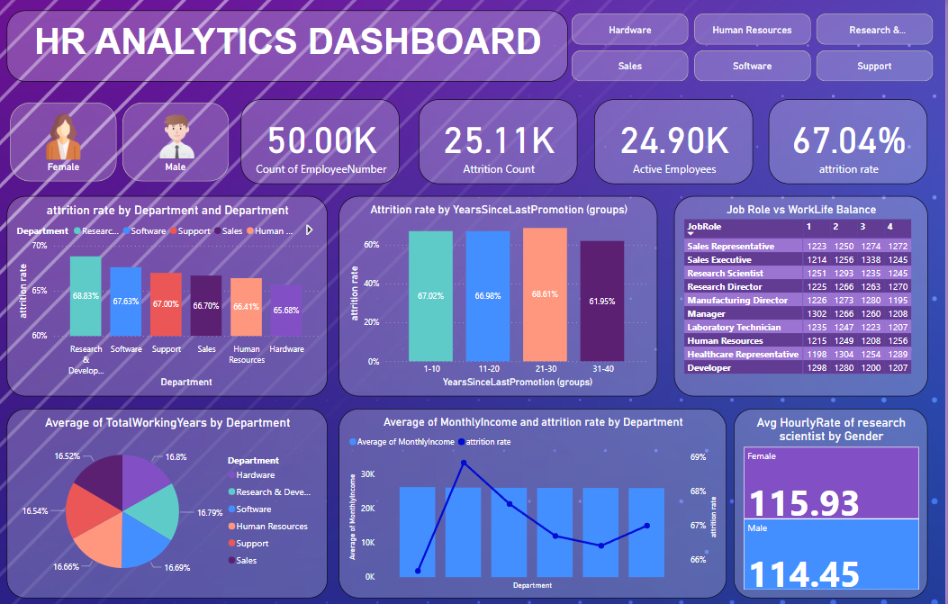
RESULTS AND DISCUSSION

Slide 10
CONCLUSION
Power BI empowers HR teams to transform raw data into actionable insights, driving a data-driven revolution in HR analytics. Here's a summary of the key takeaways:
Unlocking HR Data Potential: HR departments often grapple with vast amounts of data. Power BI bridges the gap by connecting to various HR data sources, centralizing information, and making it readily accessible for analysis.
Data Transformation & Modeling: Power BI's functionalities like Power Query and Power Pivot enable data cleaning, transformation, and model creation. This ensures data accuracy and facilitates complex analysis across different data sets.
Visual Storytelling: Power BI offers a rich set of visualizations, allowing HR professionals to translate complex data into clear and compelling stories. This fosters better communication and understanding of HR insights among stakeholders.

Slide 11
REFERENCES
Imran chowdhury, Abduk moeidi, Enamul hoque, muhammad ashad kabir, MD.Sabir hossaini, and mohammad mainul islam propossed “Designing and Evaluating Multimodal Interactions for Facilitating Visual Analysis With Dashboards”.
Mary Jane Samonte; Herick Joshua Bacer; Ronald Paolo Ramirez; Jerica Jay Tuballa published an “An Interactive Data Visualization Tool for Observing History of Fire Incidents”.
Renato Toasa1, Marisa Maximiano, Catarina Reis, David Guevara published an “Data Visualization Techniques for real-time information - A Custom and Dynamic Dashboard for Analyzing Surveys’ Results”
Alaka Das; Rakesh Chandra Balabantaray published an “MyNLIDB: A Natural Language Interface to Database”
Partha Shankar Nayak published an “Bangla web page reader – An Approach to Bangla text-to-speech conversion”

